Slide 1
Python Syntax
IN628: Intermediate Architectures and Algorithms
Semester 2, 2016
Session 11.2
Notes:
Last time we looked at the aspects of Python that were largely similar to the C-family languages
We agreed that these features were helpful in letting us get a quick start with the language
Today we will look at some places that Python syntax deviates from C-family syntax, while still focussing on the imperative paradigm
Next week we will being to look at Python’s functional programming features
You will see that many of the seemingly superficial changes that python makes are actually closely tied to its ability to support the functional paradigm

Slide 2
Sequences
Ordered sets
Notes:
Python as a language is optimised for the processing of ordered sets, or what it calls “sequences”.
We use ordered sets in other languages as well, of course, where we call them arrays or lists.
But Python provides an especially powerful structure for this with special sequence data structures and operations.
When programming in Python, therefore, the programmer is sort of directed toward the finding of set-based solutions.
We will look at several of these types and operators in a minute, but first let’s start with an example of what we mean by “special operations” by looking at Python’s slicing facility.
Slicing is like super-powered array/sequence indexing.
Since Python doesn’t have quite arrays as we know them, we are going to look at slicing first using the most fundamental sequence type of all – the string

Slide 3
Slicing
Powerful indexing on sequence types
Demonstrating with strings:
Basic indexing:
Assume the statement sequenceOfChar = “abcde”
sequenceOfChar[1]
b
sequenceOfChar[2]
c
sequenceOfChar[-1]
e
sequenceOfChar[-2]
d
Notes:
We have ordinary indexing of strings like always – note that strings are 0-indexed
But in Python we also have negative indexing to count in from the end – note that strings are not “0-indexed from the end”
This is unavoidable, as that would make 0 ambiguous.
But it’s still asymmetric, and this lower bound/upper bound asymmetry will come up again and again in Python, so we must just get used to it.
So if you want to start counting with 0, start off the end of the string.
Note that you can write code to “get the second to the last character of a string” in any language.
But note how much more work it is in C++ or Java than in Python.
The designer of Python decided that this operation is so important that it needs to be primitive. Anyone wanting to write a Python compiler has to build this in.
This reflects the importance placed on efficient expression of operations on sequences – this is core to the Python ethos.
As we proceed through our discussion of Python syntax, note how often this focus drives the syntactic decisions.

Slide 4
Slicing
sequence[start:end]
NB: start is inclusive, end is exclusive
stringOfDigits = “0123456789”
stringOfDigits[0:3]
012
stringOfDigits[4:6]
45
Notes:
In Python we have a more complex indexing option called “slicing”
Here, inside the indexing operator, you give two values
Note that start is inclusive (the character at that index is in the string) and end is exclusive (the character at that index is not in the string)
In my opinion, this is the hardest thing about Python programming

Slide 5
Slicing
stringOfDigits = “0123456789”
stringOfDigits[-4:-1]
678
stringOfDigits[-6:-4]
45
anotherString = “abcdefgh”
anotherString[1:-2]
bcdef
longerString = “abcdefghijklmnopqrstuvwxyz”
longerString[1:-2]
bcdefghijklmnopqrstuvwx
Notes:
We can, of course, also use negative indices, but the slice still goes from left to right.
The negative indices simply give us another way to describe the location of an element. They don’t go in reverse, or something. (When you write your own language, you can make it work that way..)
And you can mix these two ways of describing locations.
So this one says “from the second character up to, but not including, the second to last character”. You get that regardless of the length of the string.
You can see how useful this would be for all kinds of string stripping operations.

Slide 6
Slicing
stringOfDigits = “0123456789”
stringOfDigits[-1:-4]
returns an empty string
Notes:
But don’t ask Python to make slices that don’t make sense…
This would mean “start at last character and go right up to but not including the fourth character from the end” => can’t be done
Returns an empty string WITH NO ERROR FEEDBACK. Your job to check.

Slide 7
Slicing
Omitting an index means “all”, i.e. from the beginning or to the end
seq[start:] # from location start (inclusive) to the end of the sequence
seq[:end] # from the beginning of the seq to location end (exclusive)
someAlph = “abcdefghij”
someAlph[4:]
efghij
someAlph[:4]
abcd
someAlph[-3:]
hij
someAlph[:-3]
abcdefg
someAlph[:]
abcdefghij

Slide 8
Slicing
sequence[start:end:stepSize]
stringOfDigits = “0123456789”
stringOfDigits[0:6:2]
024
NB: When using a negative step size, the start and end arguments must describe a right-to-left slice.
NB: Even when stepping backwards, start is inclusive and end is exclusive.
stringOfDigits[6:0:-2]
642
stringOfDigits[::-1]
9876543210
Notes:
And, there is also an optional 3rd argument…for stepsize
Positive step loops up, negative step loops down, but THE INDICES MUST GO RIGHT TO LEFT
So, that’s how you reverse a string, Python-style.
How would you reverse a string in C++ (assuming you weren’t using a string class that had that feature already)?
It would be very different, wouldn’t it? The language features determine how we express, and therefore how we conceptualise, our solutions to problems.

Slide 9
Python Sequence Types
List
Tuple
Dictionary
List and Tuple are ordered collections of elements
Both List and Tuple main hold heterogeneous collections
List is mutable; Tuple is immutable
Dictionary is key:value pair storage
Notes:
Python does have a system class “array” but it is usually only used in some esoteric situations (spec. when you have decided to trade flexibility for speed)
More idiomatically, in Python you use these three “sequence types”
“Mutable” means “can be changed” (same root as “mutation)
So elements in a list can be changed after the list is created
Elements in a tuple, cannot
As we discuss the two, you should think about why the designer decided this distinction was so important that he made two separate data types that differ, really, only in this respect.

Slide 10

List
Declared and populated using []

Slide 11
Lists
listsUseSquareBrackets = ["apple", "banana", "cantaloupe"]
print(listsUseSquareBrackets[0])
apple
listsUseSquareBrackets[0] = "apricot“
print(listsUseSquareBrackets)
['apricot', 'banana', 'cantaloupe']
Notes:
Lists are indexed as you would expect
As promised, they are mutable

Slide 12
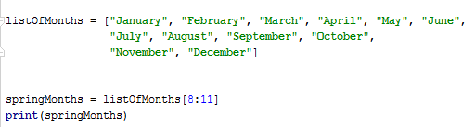
Lists
Notes:
Lists are sequence types, just like strings, so they can be sliced
You’ll have a chance on the practical to experiment with some list slicing.

Slide 13



Lists
Notes:
Slicing and assignment can be mixed to get some interesting results…
You will recall this list.
If I replace an element as shown, and print, as shown, it is as expected
But I can also replace a whole slice in one statement…(missing the umlaut in Marz)
So what do you think will happen if I try this…

Slide 14



Lists
Notes:
So what do you think will happen if I try this…
I have four locations to replace, and I have a string of four letters. Since strings are sequences, this actually works fine…
But what if there aren’t an equal number of elements?
It makes sense: replace with fewer and the list is shortened; replace with more and the list is lengthened
Again these are things you can do in any language, but you would be writing quite a lot of code to make it happen
For applications that involve set processing, this is very efficient to program.

Slide 15

Lists
Ranges of length 1 are not the same as single items
Notes:
One more note on replacing items
Note the difference between the second and third examples. In the third example, you have replaced an item with a list
In the fourth example, well, that’s just a little kooky.
Moral: the rules are very regular, but you will want to think them all the way through to the end.

Slide 16
Lists
mixedList = ["aString", 42, 3.14156, ["a", "b", "c"]]
print(mixedList)
['aString', 42, 3.14156, ['a', 'b', 'c']]
print(mixedList[3])
['a', 'b', 'c']
print(mixedList[3][0])
a
print(mixedList[3][0:2])
['a', 'b']
print(mixedList[3][-2:-1])
['b']
Notes:
As we said at the start, lists can be heterogeneous. And this doesn’t just mean they can have a mixture of int and string, they can be anything
The slicing operator behaves sensibly
Note that [3][0] returns a scalar, but [3][0:2] returns a list. Slices are sequences.
What do you think a slice of size 1 will return? => a list of one element. Slices are sequences.

Slide 17
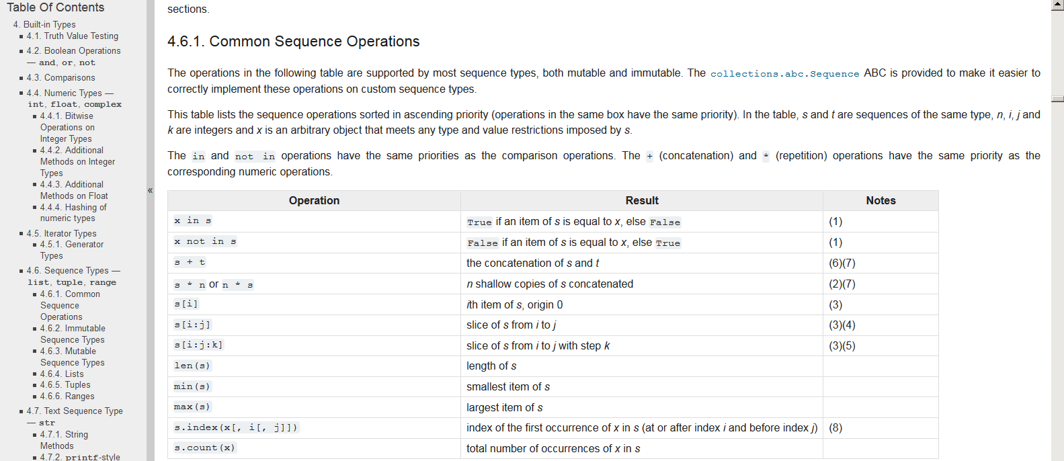
Lists
docs.python.org
Notes:
There are a ton of list operations. Again, you’ll have a chance to try them out in the practical
https://docs.python.org/3.3/library/stdtypes.html?highlight=list#sequence-types-list-tuple-range

Slide 18




Tuples
Tuples are created with ()
Tuples are immutable
Most frequently used to act like a database record
Notes:
Tuples are sequences just like lists, and they can be used just like lists, but they are immutable. That is, once declared, their elements cannot be changed.
This limits their usefulness, so they are generally seen only in restricted situations, like management of constants
We won’t cover them, but you might like to explore them on your own.
So here, we are storing information about a dog, we have the name, breed and owner.
We could have a bunch of the tuples, and if wanted to, we could keep them in a list.
Note that we can use the for…in construct that we saw last time with range to iterate over the elements of the tuple.
This works with lists as well.
You can index into tuples as you can for lists, but note that you can’t change them. This statement…throws an error

Slide 19
Dictionaries
Store data in key-value pairs
Declare with {}
Separate key and value with :
translator = {"dog" : "der Hunt", "cat" : "die Katze", "horse" : "das Pferd", "duck": "die Ente"}
translator.get("duck")
die Ente
print("duck" in translator) # prints true
print("cow" in translator) # prints false
translator["cow"] = "die Kuh"
Notes:
Every language should have a dictionary…
You search by key with the get operator, which accepts an optional argument for what to return if the fetch fails
You check for presence with the in operator
You add simply by providing a new key
Here is what you get if you print(translator) after that insertion. Note that the system will put new elements wherever it likes. Don’t count on them being in any particular location.

Slide 20
Classes
Declare with class keyword
Methods declared within the class code block (via indentation) are class methods
All methods have a first argument called self
The constructor must be called __init__
Data members:
Are not pre-declared
If created outside of any method, they are static (common to all instances of the class)
If created inside a method without prefix, they are local to the method (not data members)
If declared inside a method and prefaced with self they are class data members
Notes:
While Python will permit you to just fling code all over the place, it also provides the necessary features for declaring classes.
The syntax, however, follows the loose style of Python’s variable and method declaration.
All you need to start is the word class
Any methods in scope are class methods
Class data members, however are weird

Slide 21
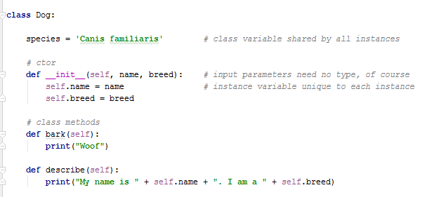
Classes
Notes:
Here’s a class
We have a constructor and two methods
There is a static variable common to all instances
There are two class data members name and breed
Note that you can also create class data members in the other methods by saying self. But this could be risky is variables are inadvertently accessed before they are created (which will cause an error), so best to create everything in the constructor.
To create instances, we call the constructor; to access data and methods we use the expected dot notation….

Slide 22
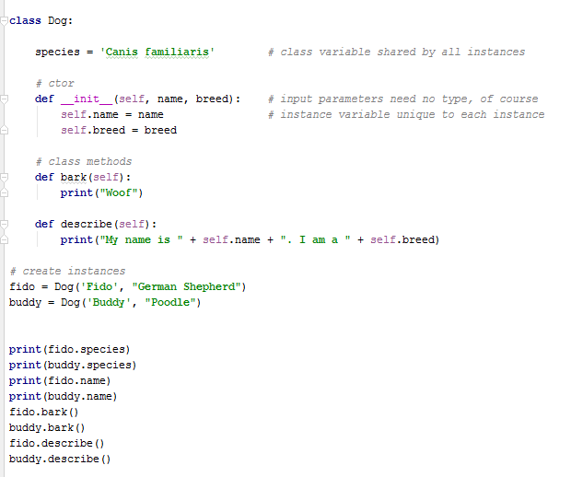
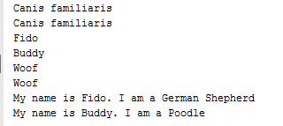
Classes
Notes:
…produces the output shown.
What do you think will happen if I try to access an undeclared class data member? => throws an error “Dog object has no attribute weight

Slide 23
Practical

